Slide 1
Special Course in Software Engineering 24
MINI-PROJECT PRESENTATION
GROUP NO. 24: Confusion Matrix

Slide 2
Group Introduction

Slide 3
Project module and module leader
Module Name | Module leaders
Data Inspection and Plotting | Qihao Zhuang, Yifan Li
Analysis and Hypothesis Testing | Bo Zhang, Yifan Li
Sentiment Analysis (NLP) | Yikai Zhang, Yifan Li
Data Cleaning and preprocessing | Yifan Li
Main Module | Yifan Li

Slide 4
Dataset

Slide 5
Dataset introduction
Dataset name:
Heart attack prediction dataset
Brief description:
The Heart Attack Risk Prediction Dataset is a valuable tool for understanding the predictors of heart health and the risk factors associated with heart attacks.
It includes diverse attributes such as age, cholesterol levels, lifestyle choices, and medical history, enabling researchers and healthcare professionals to apply predictive analytics and machine learning for proactive heart disease prevention.
With 8,763 records from patients worldwide, this dataset supports comprehensive analysis and research aimed at improving cardiovascular health outcomes.

Slide 6
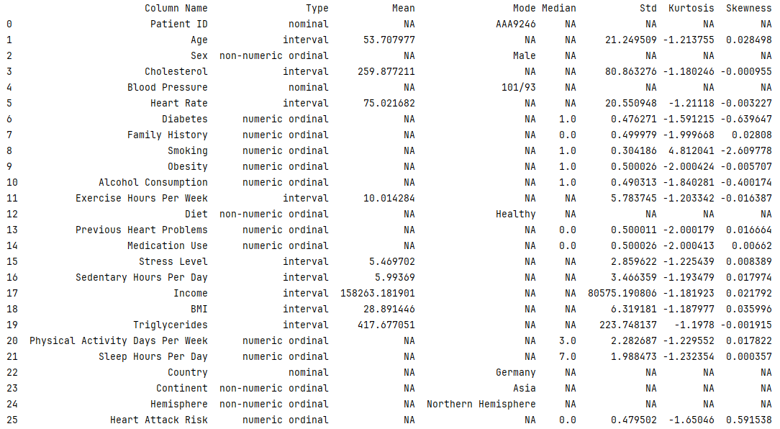

Slide 7
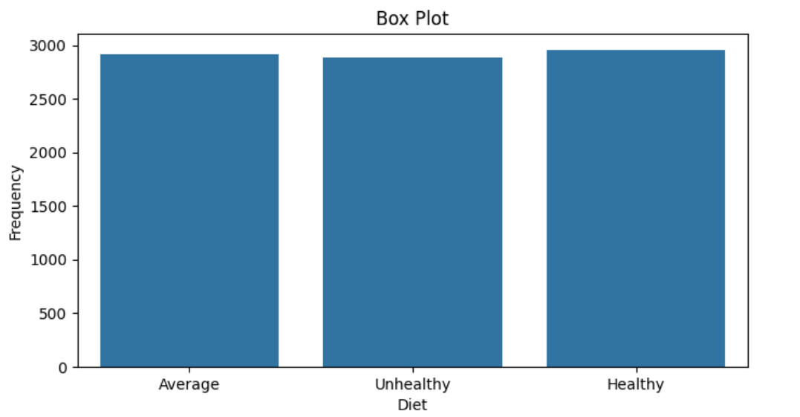
(Variable Name #Diet) distribution
This box plot compares three categories: Average, Unhealthy Diet, and Healthy.
The plot shows little to no variation within each category, as the boxes appear as single lines without visible whiskers or outliers.
All three categories have similar frequency values, around 2900-3000, with the Healthy category showing a slightly higher frequency than the others.

Slide 8
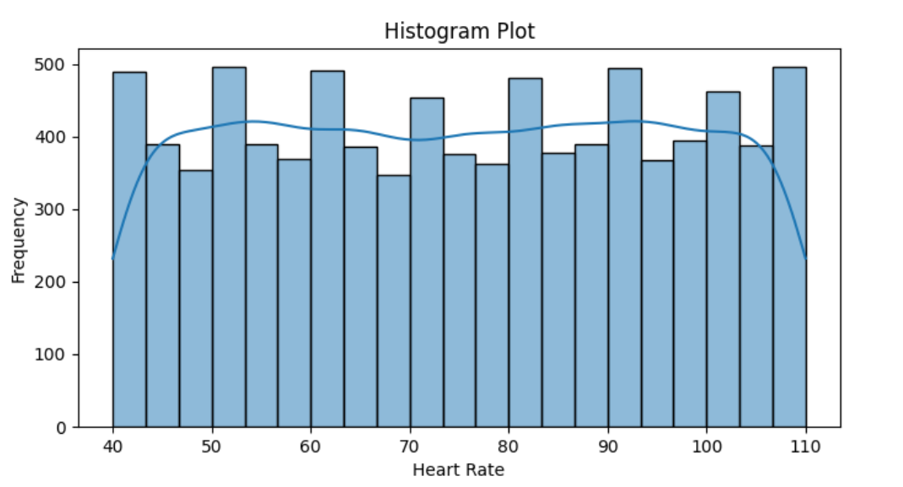
(Variable Name # Heart Rate) distribution
This histogram shows the distribution of heart rates.
The data exhibits a roughly normal distribution shape, with most heart rates concentrated in the middle range (about 70-90 beats per minute).
The distribution is slightly right-skewed, indicating that higher heart rates occur somewhat more frequently than lower ones.

Slide 9
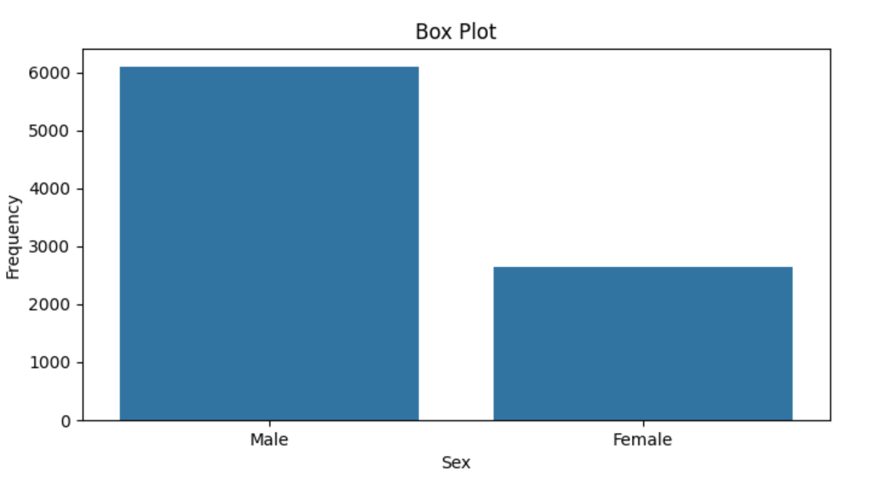
(Variable Name # Gender) distribution
This box plot compares the frequency distribution between Male and Female categories.
The Male category shows a significantly higher frequency, around 6000, compared to the Female category, which has a frequency of about 2700. The plot displays no variability within each category, appearing as single bars rather than traditional box plots with quartiles and whiskers.
This suggests the data represents aggregate counts or averages for each gender rather than individual data points.

Slide 10
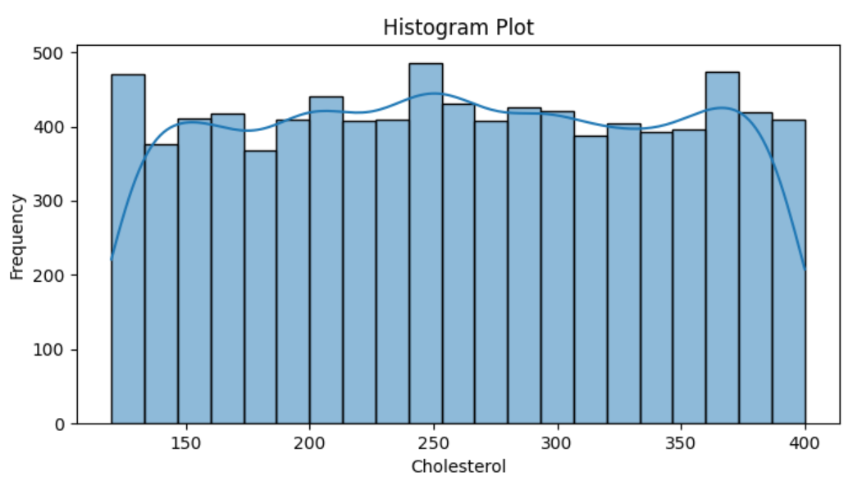
(Variable Name # Cholesterol) distribution
This histogram displays the distribution of cholesterol levels.
The data shows a relatively uniform distribution across most cholesterol values, with frequencies generally ranging between 350-450. There are slight peaks around 250 and 375 cholesterol levels. The blue line overlaid on the bars represents a smoothed trend of the distribution, highlighting these subtle variations.
Overall, the distribution doesn't show a strong central tendency, suggesting a wide range of cholesterol levels in the population sampled.

Slide 11
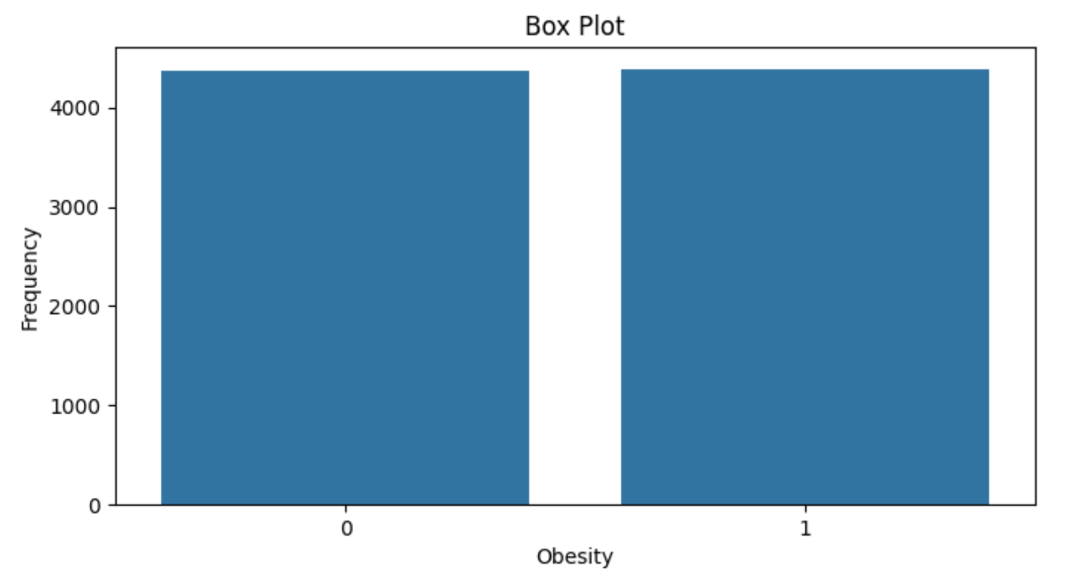
(Variable Name # Obesity) distribution
This box plot compares two categories related to obesity, likely representing non-obese (0) and obese (1) individuals.
Both categories show nearly identical frequencies, around 4400-4500. The plot displays no variability within each category, appearing as single bars rather than traditional box plots with quartiles and whiskers.
This suggests the data represents aggregate counts or averages for each obesity status, with a remarkably even distribution between the two groups in the sampled population.

Slide 12
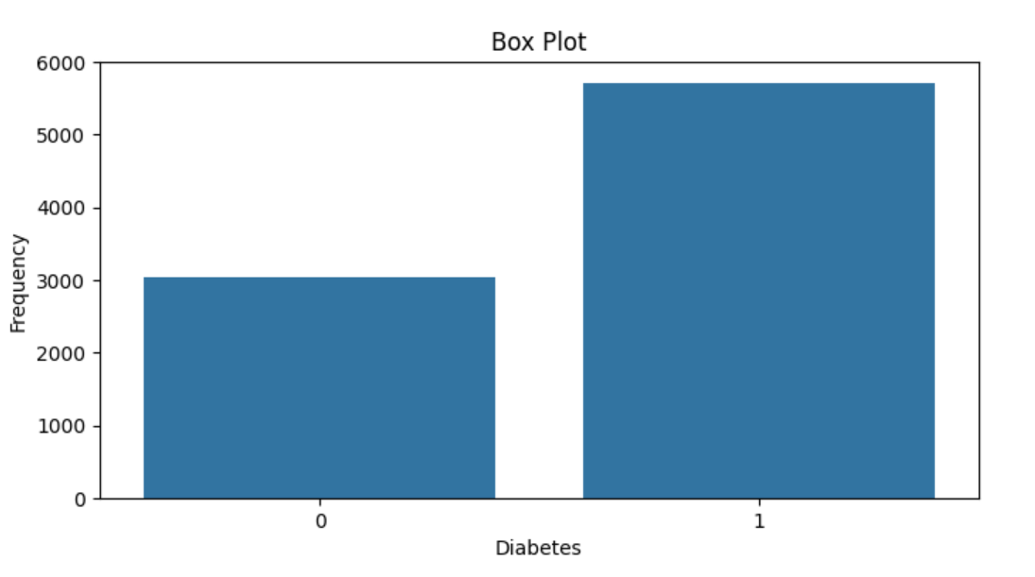
(Variable Name # Diabetes) distribution
This box plot compares the frequency of two categories related to diabetes, likely representing non-diabetic (0) and diabetic (1) individuals.
The diabetic category (1) shows a much higher frequency, around 5700, compared to the non-diabetic category (0), which has a frequency of about 3000.
The plot displays no variability within each category, appearing as single bars rather than traditional box plots, suggesting these are aggregate counts for each group.

Slide 13
Analysis

Slide 14
Hypothesis #1：Analyze numeric and category data.
Analyze：
Data: Diet (Healthy, Average, Unhealthy) vs. Heart Rate
Numeric data：Heart Rate
Category data： Diet (Healthy, Average, Unhealthy)
Hypothesis：
H₀ (Null Hypothesis) : There is no significant effect of diet on heart rate.
H_{a} (Alternative Hypothesis) : There is a significant effect of diet on heart rate.

Slide 15
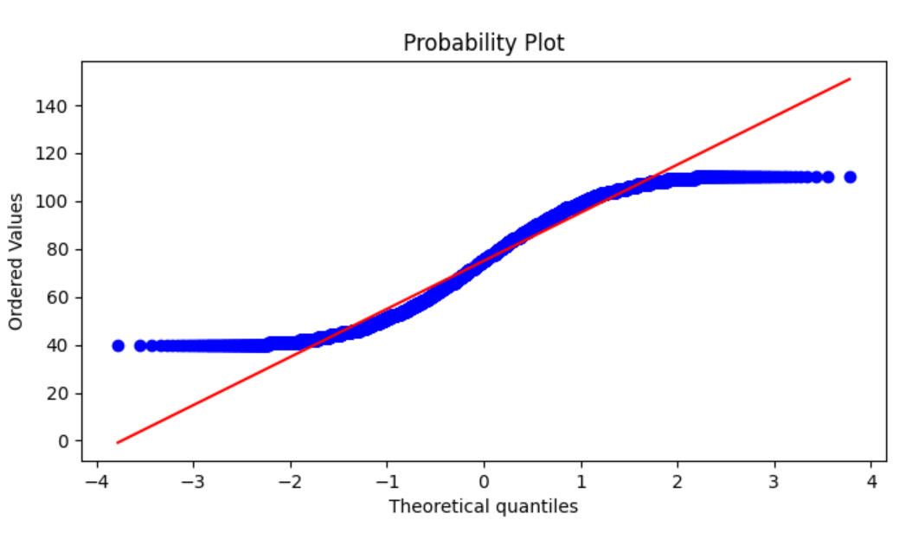
Testing Hypothesis #1
This probability plot compares the distribution of observed values (blue dots) to a theoretical normal distribution (red line).
The S-shaped curve of the data points suggests the distribution is not perfectly normal.
The middle range aligns more closely with the normal line, while deviations are more pronounced in the lower and upper quantiles.

Slide 16
Testing Hypothesis #1
"Anderson-Darling": {
"test": "Anderson-Darling",
"statistic": 102.29183776167338,
"p_value": 0.0,
"is_normal": false
}
"Kruskal-Wallis": {
"test": "Kruskal-Wallis",
"statistic": 8762.000000000002,
"p_value": 0.49799089453512324,
"is_significant": false
}
1. Anderson-Darling Test
The Anderson-Darling test is a non-parametric test used to determine whether a dataset follows a normal distribution. The statistic value of 102.29 indicates a very high degree of deviation from normality.
The p-value of 0.0 provides very strong evidence to reject the null hypothesis, which states that "the data follows a normal distribution." Therefore, the result indicates that the data does not conform to a normal distribution.
2. Kruskal-Wallis Test
The Kruskal-Wallis test is a non-parametric method used to compare three or more independent samples, similar to one-way ANOVA. Here, the statistic value is 8762.00.
The p-value of 0.498, which is above the common significance level (e.g., 0.05), indicates that there is not enough evidence to reject the null hypothesis, which states that there are no significant differences between the different samples. Therefore, the result suggests that there are no significant differences in medians among the samples.

Slide 17
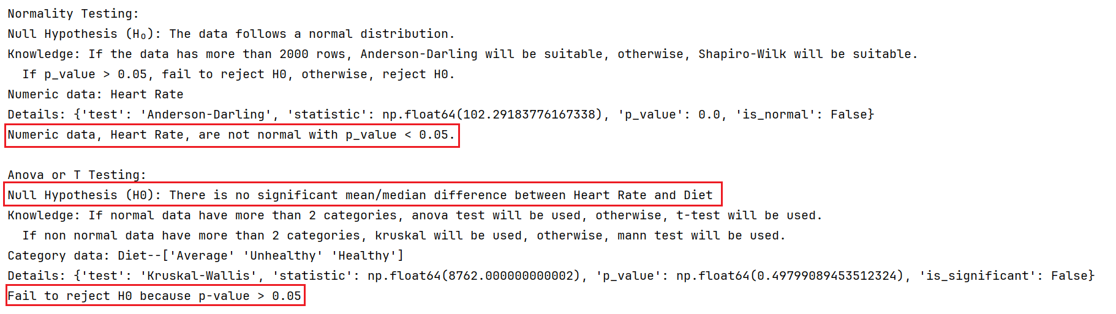
Testing Hypothesis #1
The Anderson-Darling test indicates that the data does not follow a normal distribution, while the Kruskal-Wallis test shows that there are no significant differences among the samples.

Slide 18
Hypothesis #2：Analyze numeric and category data.
Analyze：
Data: Sex vs. Cholesterol
Numeric data：Cholesterol
Category data： Sex
Hypothesis：
H₀ (Null Hypothesis) : There is no significant effect of gender on Cholesterol.
H_{a} (Alternative Hypothesis) : There is a significant effect of gender on Cholesterol.

Slide 19
Testing Hypothesis #2
This probability plot compares the distribution of observed values (blue dots) to a theoretical normal distribution (red line).
The S-shaped curve of the data points suggests the distribution is not perfectly normal.
The middle range aligns more closely with the normal line, while deviations are more pronounced in the lower and upper quantiles.

Slide 20
Testing Hypothesis #2
"Anderson-Darling": {
"test": "Anderson-Darling",
"statistic": 91.34459292230349,
"p_value": 0.0,
"is_normal": false
}
"Mann-Whitney U": {
"test": "Mann-Whitney U",
"statistic": 0.0,
"p_value": 1.0,
"is_significant": false
}
1. Anderson-Darling Test
The Anderson-Darling test is a non-parametric test used to determine whether a dataset follows a normal distribution. The statistic value of 91.34 indicates a significant deviation from normality.
The p-value of 0.0 provides strong evidence to reject the null hypothesis, which states that "the data follows a normal distribution." Thus, the result shows that the data does not conform to a normal distribution.
2. Mann-Whitney U Test
The Mann-Whitney U test is a non-parametric test used to assess whether there are differences between two independent samples. The statistic value of 0.0 suggests that one group has a lower rank than the other.
However, the p-value of 1.0 indicates that there is no significant difference between the two groups. Therefore, the result suggests that the difference between the groups is not statistically significant.

Slide 21
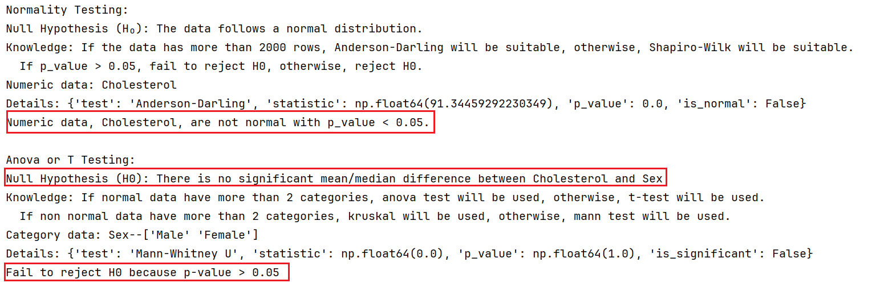
Testing Hypothesis #2
The results indicate that the data does not follow a normal distribution, as shown by the significant Anderson-Darling test statistic and p-value.
Mann-Whitney U test results suggest that there is no significant difference between the two independent samples.

Slide 22
Hypothesis #3：Analyze category data.
Analyze：
Data: Diabetes VS Obesity
Category data： Diabetes
Category data： Obesity
Hypothesis：
H₀ (Null Hypothesis) : There is no significant difference between Diabetes on Diabetes.
H_{a} (Alternative Hypothesis) : There is a significant difference between Diabetes on Diabetes.

Slide 23
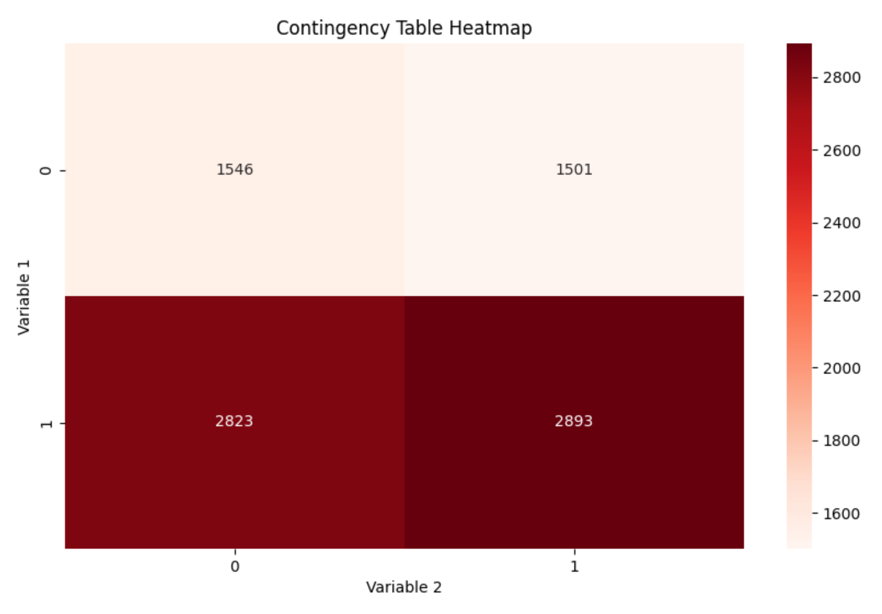
Testing Hypothesis #3
This contingency table heatmap shows the relationship between two variables, each with two categories (0 and 1). The data is presented in a 2x2 grid:
The top row (Variable 1 = 0) shows 1546 cases for Variable 2 = 0, and 1501 cases for Variable 2 = 1.
The bottom row (Variable 1 = 1) shows 2823 cases for Variable 2 = 0, and 2893 cases for Variable 2 = 1.
The color intensity indicates frequency, with darker red representing higher values. The bottom row has noticeably darker colors, indicating higher frequencies for Variable 1 = 1 across both categories of Variable 2.
The distribution within each row is relatively even, suggesting little correlation between the two variables.

Slide 24
Testing Hypothesis #3
Chi Square Test
Test: The type of statistical test performed, which is the Chi-Square test.
Statistic: The calculated test statistic value, approximately 1.40. This value indicates how much the observed frequencies deviate from the expected frequencies.
p_value: The p-value is approximately 0.24. This value tells us the probability of observing the test results under the null hypothesis (that there is no association between the variables).
Is Significant: The boolean value false indicates that the p-value is greater than the common significance level (0.05), meaning we do not reject the null hypothesis.
details = {
'test': 'Chi-Square',
'statistic': np.float64(1.396992947634959),
'p_value': np.float64(0.23722769870856877),
'is_significant': False
}

Slide 25
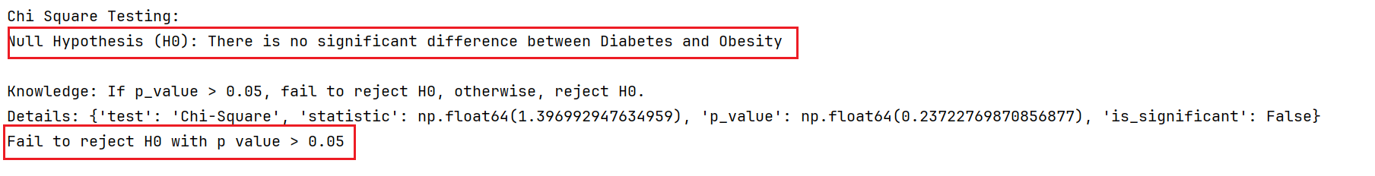
Testing Hypothesis #3
Thus, there is not enough evidence to suggest a significant association between the two variables (Diabetes and Obesity).

Slide 26
Hypothesis #4：Analyze numeric data.
Analyze：
Data: Age VS Income
Category data： Age
Category data： Income
Hypothesis：
H₀ (Null Hypothesis) : There is no significant difference between Age on Income.
H_{a} (Alternative Hypothesis) : There is a significant difference between Age on Income.

Slide 27
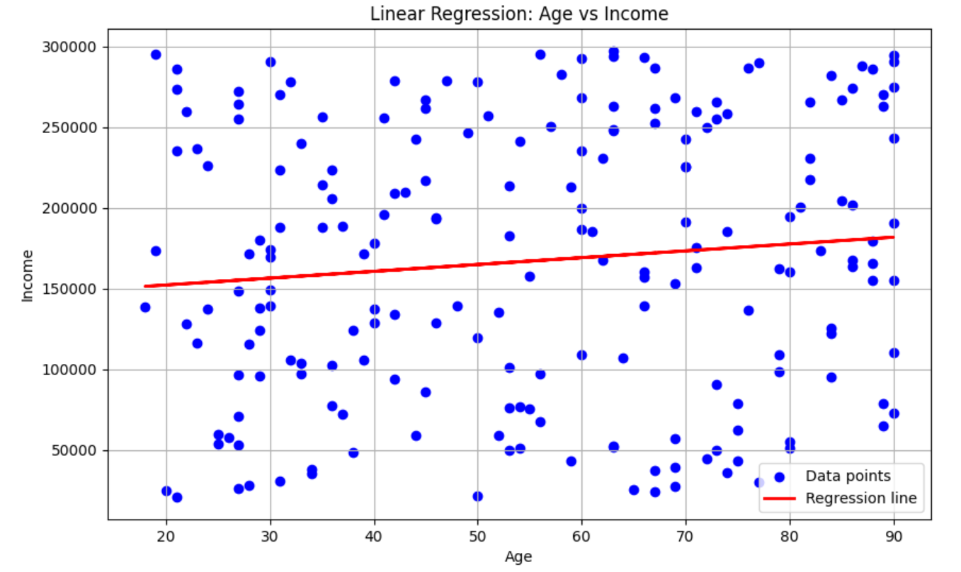
Testing Hypothesis #4
This scatter plot shows the relationship between Age (x-axis) and Income (y-axis) with a linear regression line. The data points (blue dots) are widely scattered, indicating high variability in income across all age groups.
The red regression line has a slight positive slope, suggesting a weak positive correlation between age and income. However, the large spread of data points around the line indicates that age alone is not a strong predictor of income.
There are many instances of both high and low incomes across the entire age range, from about 20 to 90 years old.

Slide 28
Testing Hypothesis #4
Linear Regression
Linear regression is a statistical method used to model the relationship between a dependent variable and one or more independent variables by fitting a linear equation to the data.
It aims to find the best-fitting line that minimizes the differences between observed and predicted values. The model is evaluated using metrics like R-squared, which indicates how well the independent variables explain the variance in the dependent variable.
Linear regression is widely used for prediction and forecasting in various fields such as economics, finance, and social sciences.

Slide 29
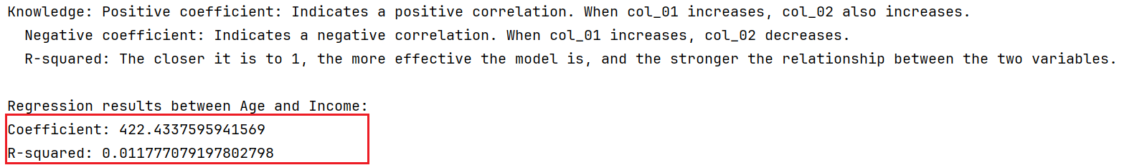
Testing Hypothesis #4
The regression results for "Age and Income" show that the coefficient is 422.4337595941569, while the R-squared value is only 0.011777079197802798, indicating that the model fits the data poorly and there is a weak relationship between the two variables.

Slide 30
(NOT MANDATORY)
Interesting results
BONUS – 5 points

Slide 31
Interesting Hypothesis (NOT MANDATORY)
(
Provide details of any other interesting hypothesis you tested.
Were the results also interesting? Why?
Example (Titanic dataset):
H₀ : There is no relationship between point of embarkation and survival rate
H_{a} : There is a relationship between point of embarkation and survival rate
)

Slide 32
Interesting Hypothesis (NOT MANDATORY)
**Please note that the BONUS 5 POINTS will be given only if the teachers are convinced that the results are interesting.

Slide 33
End

